Slide 1
Medical Image Segmentation Brain Tumor
NIKHIL BHATNAGAR 199302121 AADITYA SHARMA 199302117

Slide 2
PROBLEM STATEMENT
To automate the process of segmenting brain tumor regions in MRI images by implementation of Convolutional Neural Network. A UNet based model that will be able to accurately locate the tumor regions in brain and perform semantic segmentation for obtaining accurate output images for the same.

Slide 3

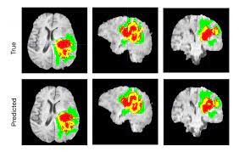
IMAGE SEGMENTATION
Image segmentation is a method in which a digital image is broken down into various subgroups called Image segments which helps in reducing the complexity of the image to make further processing or analysis of the image simpler.
Segmentation in easy words is assigning labels to pixels. Segmentation has an important role in medical imaging as it helps in extracting the organ of interest.

Slide 4
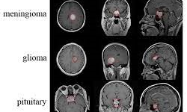
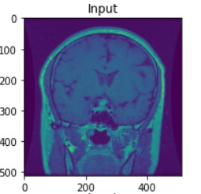
BRAIN TUMOR
A brain tumor is a collection, or mass, of abnormal cells in your brain. Your skull, which encloses your brain, is very rigid. Any growth inside such a restricted space can cause problems. Brain tumors can be cancerous (malignant) or noncancerous (benign).
Detection of brain tumor using a segmentation approach is critical in cases, where survival of a subject depends on an accurate and timely clinical diagnosis.
Gliomas are the most found tumours having irregular shape and ambiguous boundaries, making them one of the hardest tumours to detect.
Our system also covers Meningioma and Pituitary Tumor which are some of the most common forms of brain tumor usually found.

Slide 5
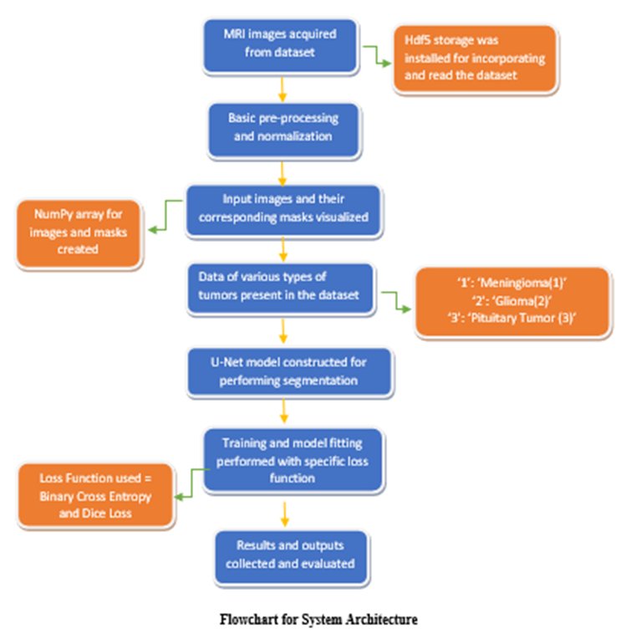
METHODOLOGY

Slide 6
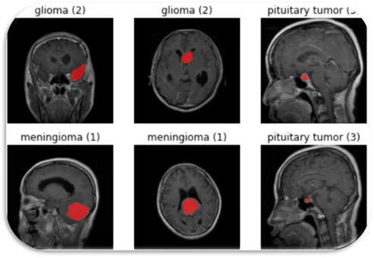
DATASET
MRI Image acquired from dataset
This brain tumor dataset containing 3064 T1-weighted contrast-enhanced images from 233 patients with three kinds of brain tumor:
meningioma (708 slices)
glioma (1426 slices)
pituitary tumor (930 slices).

Slide 7
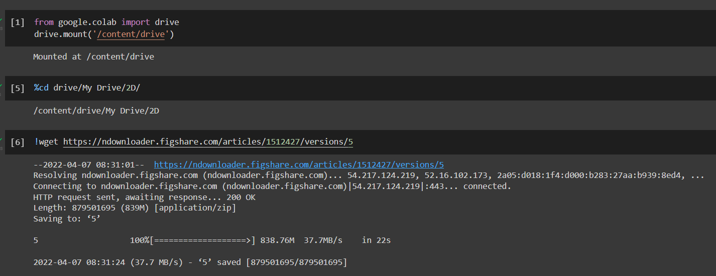
CODE SNIPPET
Connecting google colab environment with the drive.
Using ‘!wget’ command we download the dataset from the net.

Slide 8
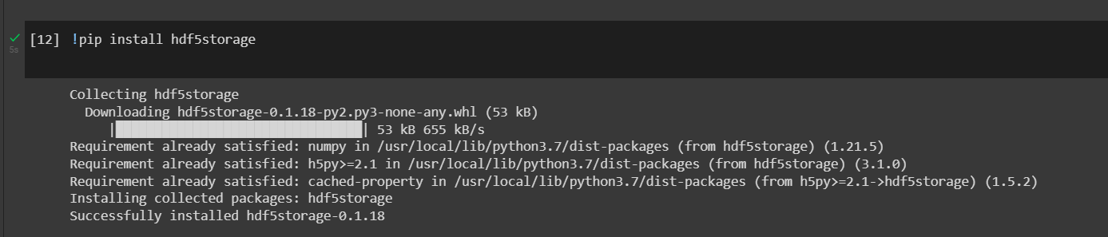
CODE SNIPPET
This Python package provides high level utilities to read/write a variety of Python types to/from HDF5 (Heirarchal Data Format) formatted files.
This package also provides support for MATLAB MAT v7.3 formatted files, which are just HDF5 files with a different extension and some extra meta-data.

Slide 9
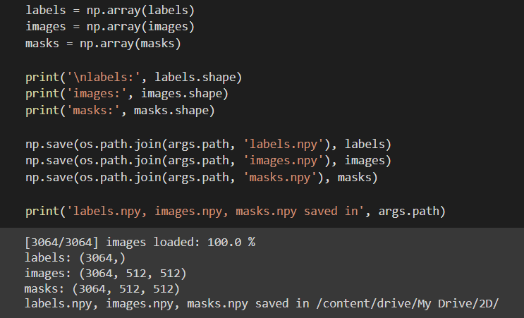
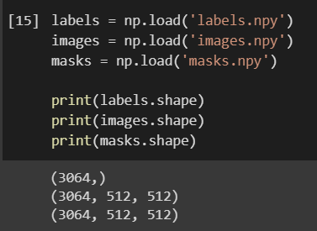
CODE SNIPPET

Slide 10
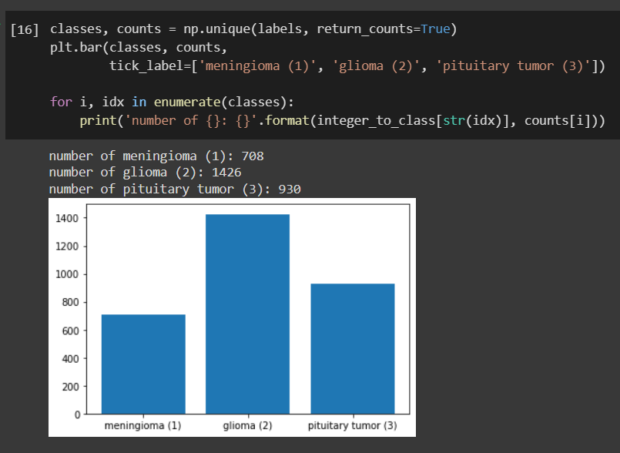
CODE SNIPPET
Frequency of each kind of tumor present in the Dataset

Slide 11
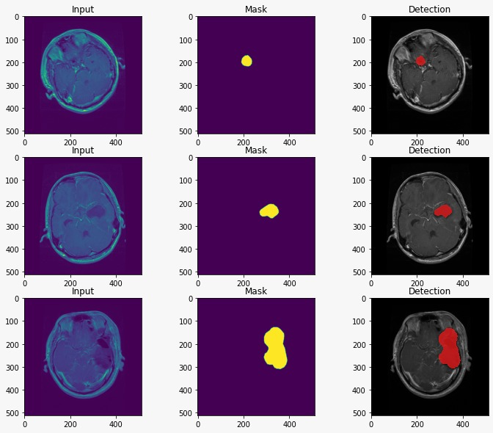
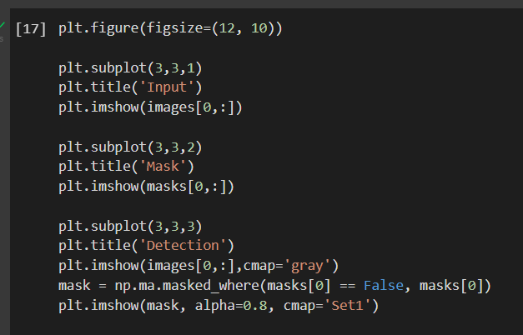
CODE SNIPPET

Slide 12
CNN
CNN stands for Convolutional Neural Network, is used for the classification of images. The input images which are used in CNN are of 3 dimensions i.e., height, width, and number of channels. First two dimensions tell us the image resolution. And third dimension represents the number of channels (RGB) or intensity values for red, green and blue colors. Usually, images which are fed into the neural network are reduced in dimensions which reduce the processing time and avoid the problem of under fitting.
Convolutional Neural Networks (CNNs) are multi-layer feedforward networks specifically designed to recognize features in 2-dimensional image data. CNNs are primarily used for 2D image recognition, so we will illustrate their architecture on a 2D rectangular image consisting of pixels. Each pixel generally carries color information. Colon can be represented by multiple channels (e.g- 3 RGB channels). The essence of CNNs is the convolutions. The main trick with convolutional networks that avoids the problem of too many parameters is sparse connections

Slide 13
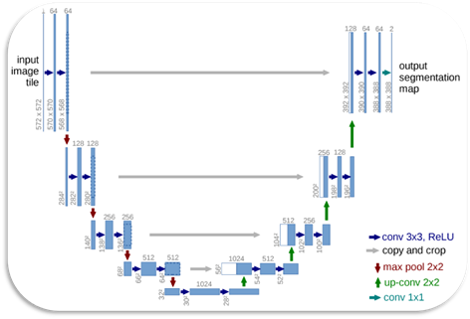
UNET ARCHITECTURE
The architecture contains two paths. First path is the contraction path (also called as the encoder) which is used to capture the context in the image. The encoder is just a traditional stack of convolutional and max pooling layers.
Each blue box corresponds to a multi-channel feature map. The number of channels is denoted on top of the box. The x-y-size is provided at the lower left edge of the box. White boxes represent copied feature maps. The arrows denote the different operations.
The task in image segmentation is to take an image and divide it into several smaller fragments. These fragments or these multiple segments produced will help with the computation of image segmentation tasks.
For image segmentation tasks, another essential requirement is the use of masks. With the help of masking, which is basically a binary image consisting of zero or non-zero values, we can obtain the desired result required for the segmentation task.
With this U-Net architecture, the segmentation of images of sizes 512X512 can be computed with a modern GPU within small amounts of time.

Slide 14
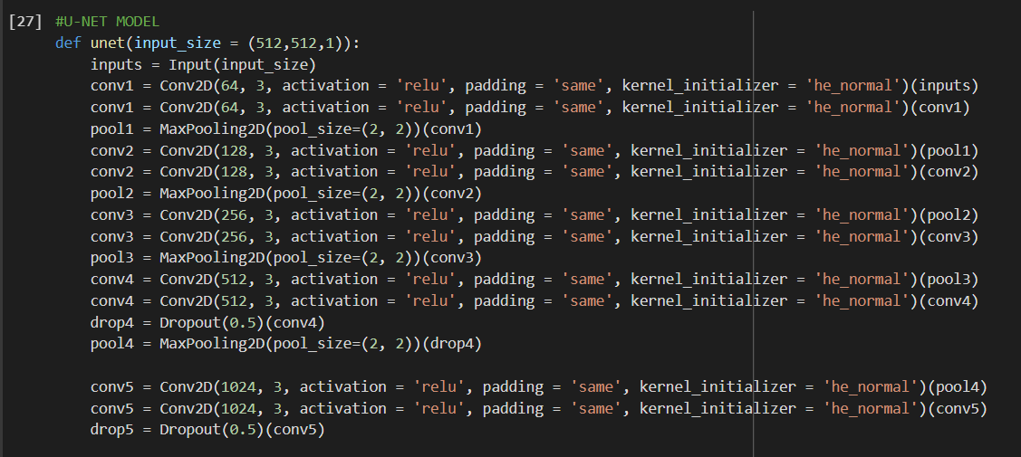
CODE SNIPPET

Slide 15
WORK DONE
Acquired the right Dataset of MRI images and visualized it correctly with the help of Hdf5 storage for (.mat) formats. Plotted the corresponding masks of the input images and looked at how to go on about constructing the final output images.
Created a graphical representation of the various types of Tumors present in the dataset and changed the images to gray scale.
A functional U-Net model is being built to accurately segment the MRI images. Certain skip functions might be applied for more accuracy in results later.

Slide 16
RESULT
After constructing the UNet model for our segmentation task, work is in progress for training the model on this architecture. Successive tasks to be achieved are to incorporate the loss functions and successfully train the model with high accuracy to determine exact location of the tumor regions present in the MRI images.

Slide 17
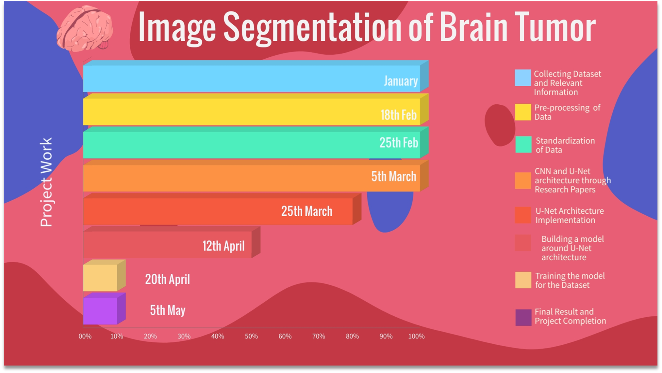


Slide 18
FUTURE PLANS
Incorporate 3D volumetric features on MRI images
Improve the functionality of the model on large datasets and improve the overall accuracy.

Slide 19
Thank You!

